Slide 1

Note: The data and information in this document is reflective of a hypothetical situation and client. This document is to be used for KPMG Virtual Internship purposes only.
Sprocket Central Pty Ltd
Data analytics approach

Slide 2
Note: The data and information in this document is reflective of a hypothetical situation and client. This document is to be used for KPMG Virtual Internship purposes only.
Agenda
Introduction
Data Exploration
Model Development
Interpretation

Slide 3

Note: The data and information in this document is reflective of a hypothetical situation and client. This document is to be used for KPMG Virtual Internship purposes only.
Introduction
The attributes took into consideration to come up with a recommendation for our top customers:
Past 3 year bike related purchases
Job Industry Category
Wealth Segment
Cars owned
States

Slide 4
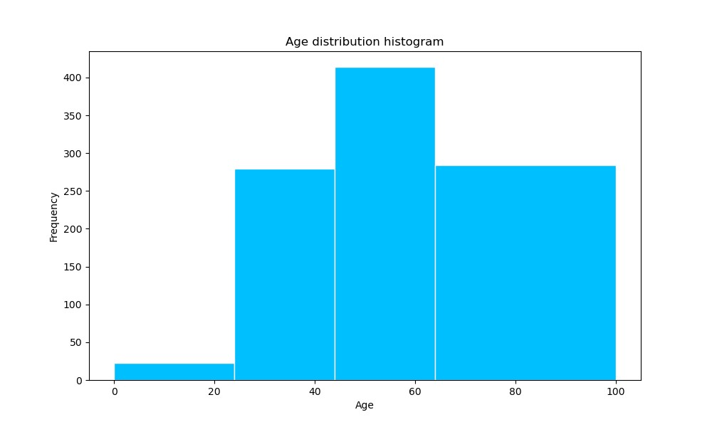
Note: The data and information in this document is reflective of a hypothetical situation and client. This document is to be used for KPMG Virtual Internship purposes only.
Data Exploration
INSIGHTS FROM THE AGE DISTRIBUTION OF NEW CUSTOMERS
This age distribution shows that:
The New Customers List consists majorly of people between 45 & 65.
There are very few people in the range of 10 to 25 .

Slide 5
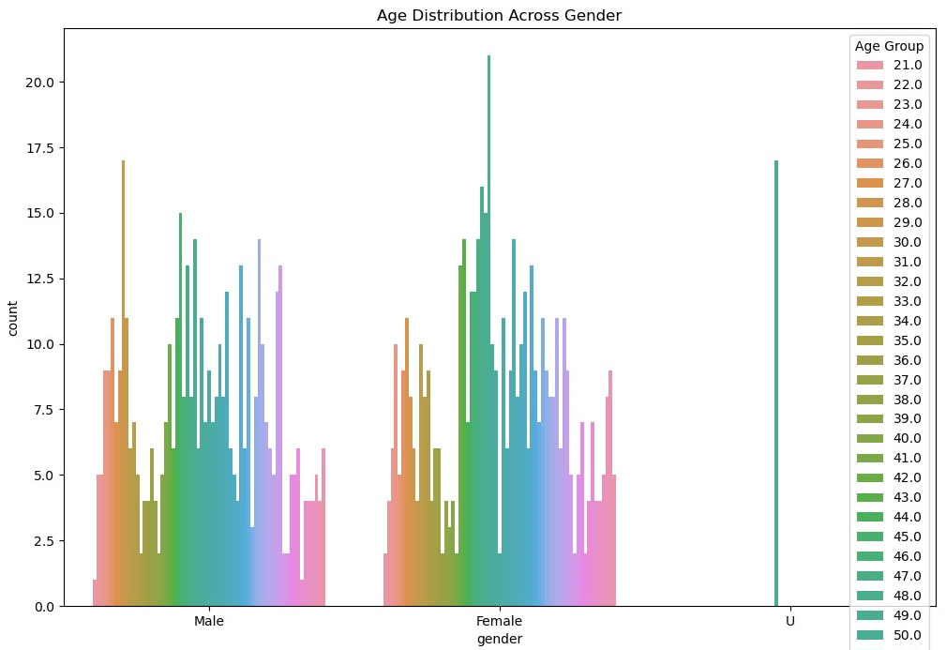
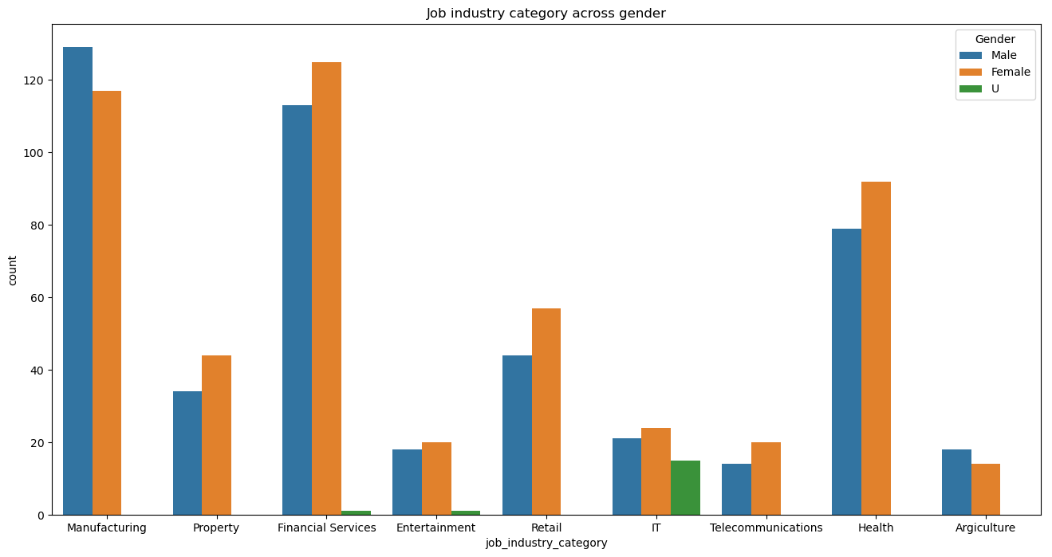
Note: The data and information in this document is reflective of a hypothetical situation and client. This document is to be used for KPMG Virtual Internship purposes only.
Data Exploration
This plot depicts the age group across the gender
The insights to be noted are:
Female are more dominant.
So, for obvious reasons of dominance in the job industry,the targeting strategy have to be more inclined towards the females as compared to males.

Slide 6
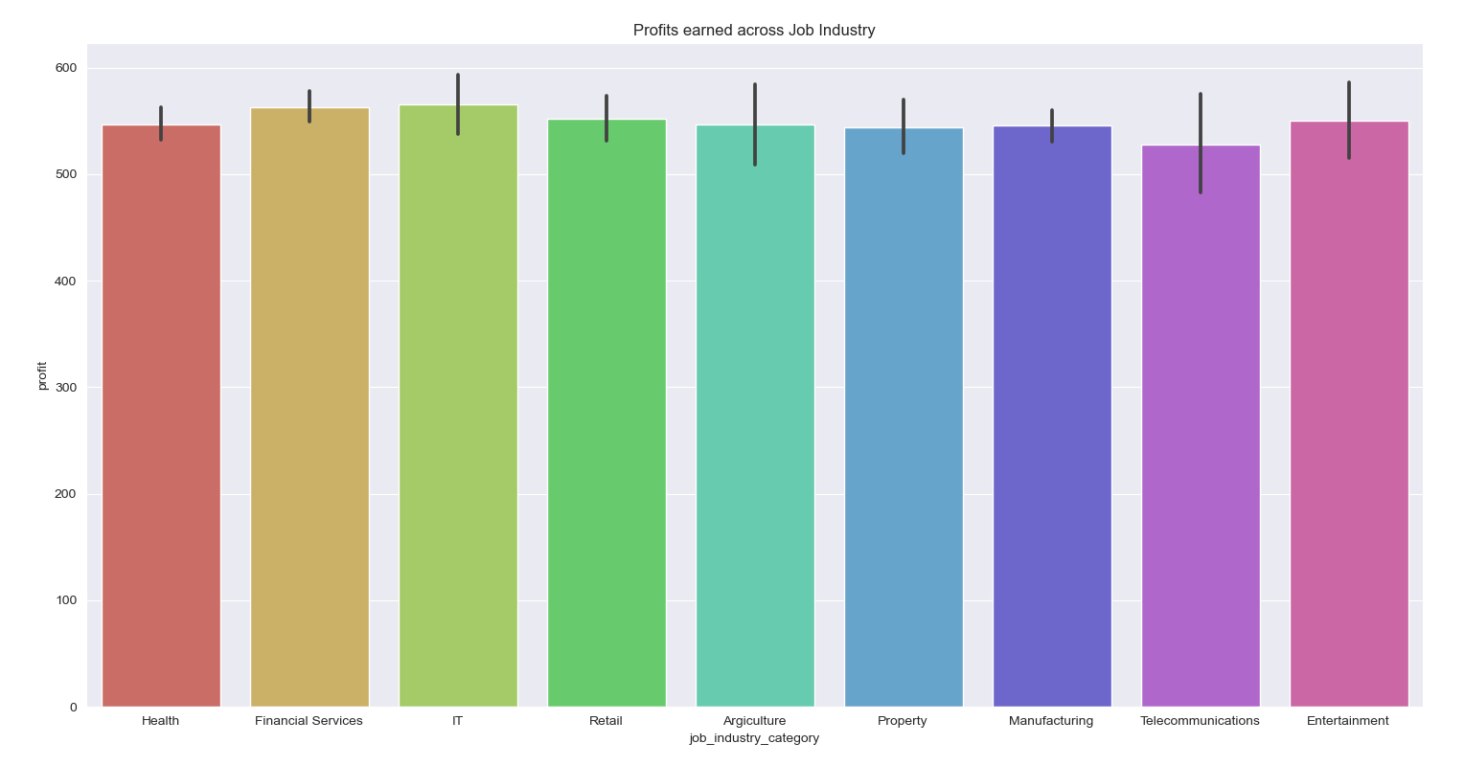
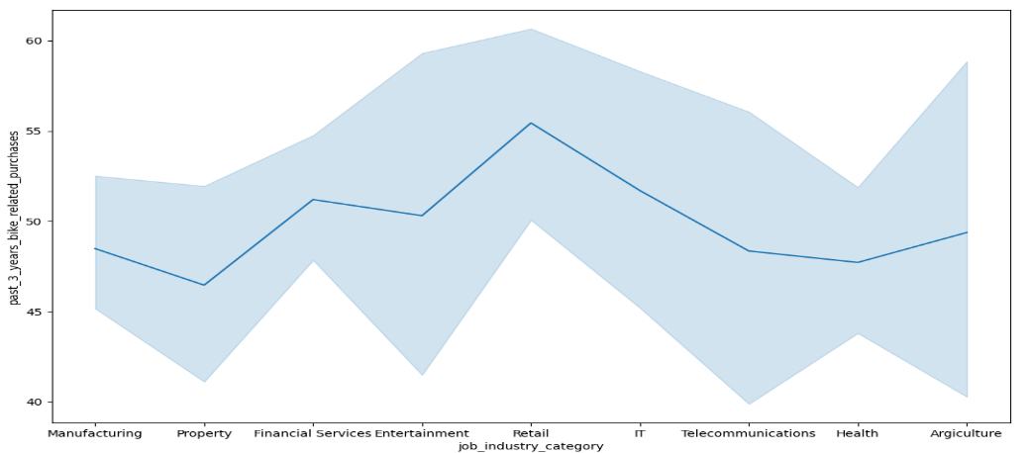
Note: The data and information in this document is reflective of a hypothetical situation and client. This document is to be used for KPMG Virtual Internship purposes only.
Data Exploration
INSIGHTS ON JOB INDUSTRY
This plots shows that:
Majority of profits are obtained by Financial, IT, Health and Retail industries.
The Retail industry has made bike related purchases followed by Financial and IT industries.

Slide 7
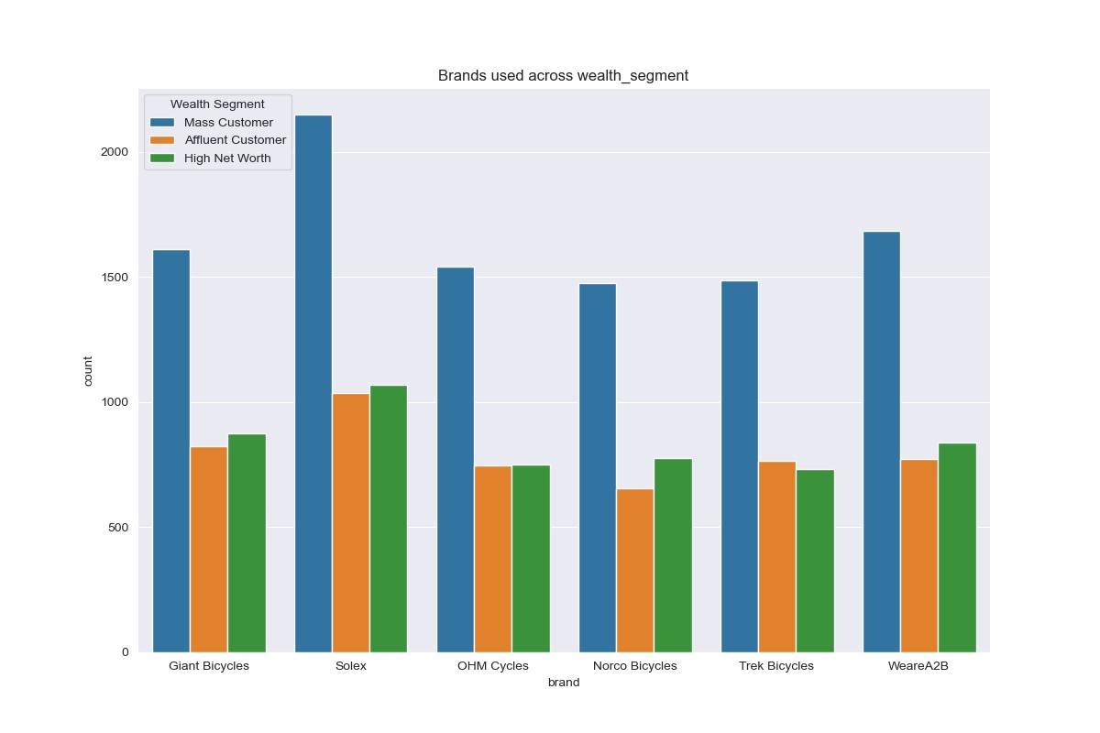
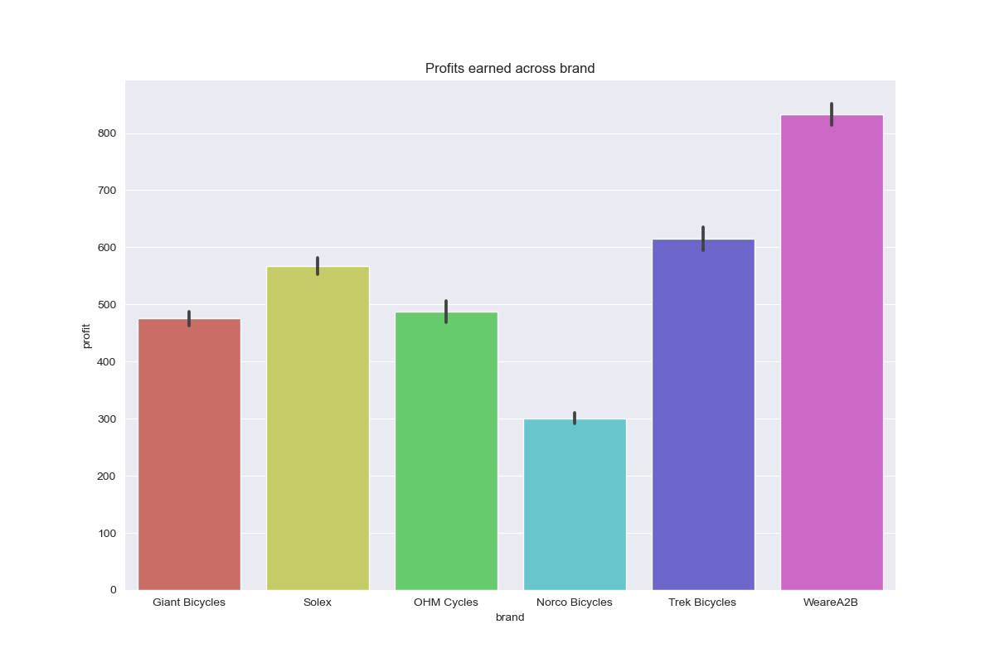
Note: The data and information in this document is reflective of a hypothetical situation and client. This document is to be used for KPMG Virtual Internship purposes only.
Data Exploration
INSIGHTS ON THE PROFIT OF BRANDS
This distribution shows that:
The Brand WeareA2B is more profitable followed by Trek Bicycles and Solex. And also, the most used brand among mass customers is Solex.

Slide 8
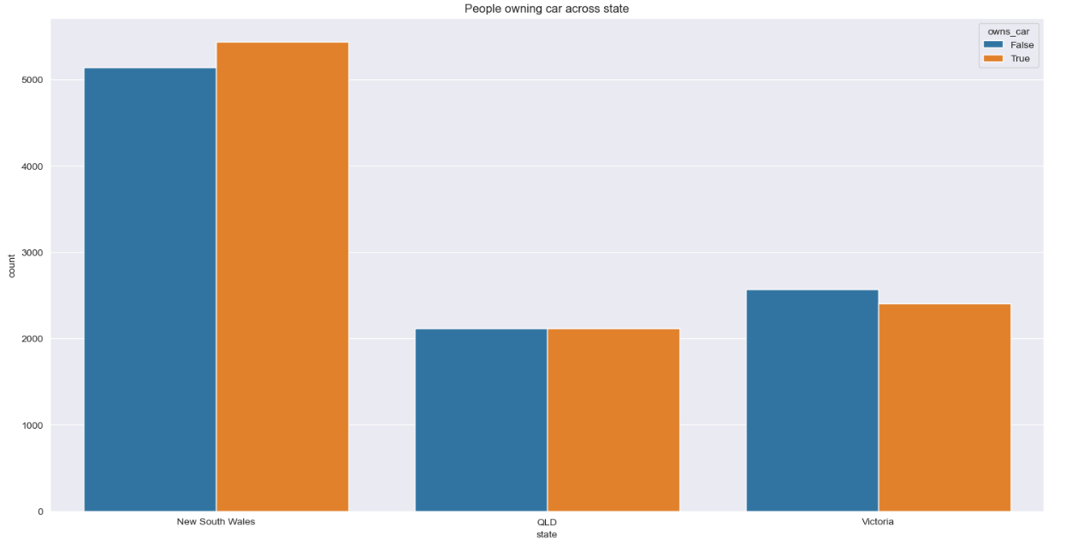
Note: The data and information in this document is reflective of a hypothetical situation and client. This document is to be used for KPMG Virtual Internship purposes only.
Model Development
This plot depicts the age group across the gender
The insights to be noted are:
The State ‘ New South Wales ’ would be best target to pick customers as the number of people who do not own car are as equal to people owning car. This can become our opportunity.
Moreover, we can bring out some schemes so that the customers in QLD & Victoria would also buy our bicycles.

Slide 9

Note: The data and information in this document is reflective of a hypothetical situation and client. This document is to be used for KPMG Virtual Internship purposes only.
Model Development
So, who are our high targeted customers?
From the New Customer List, the high value customers would be:
An Age group of 45-55
Majority of high value customers are females
High valued and profitable industries are Financial, IT, Health and Retail industries
Customers currently living New South Wales and Victoria

Slide 10
Note: The data and information in this document is reflective of a hypothetical situation and client. This document is to be used for KPMG Virtual Internship purposes only.
THANK YOU

